Slide 1
MIPD Model informed precision dosing
12/13/2024
Takuto Takahashi, MD, PhD
Assistant Professor, Pediatrics, Harvard Medical School
Attending physician, Pediatric Stem Cell Transplant, Dana-Farber Cancer Institute/Boston Children’s Hospital
Adjunct Professor, Experimental and Clinical Pharmacology, UMN

Slide 2
No COI

Slide 3
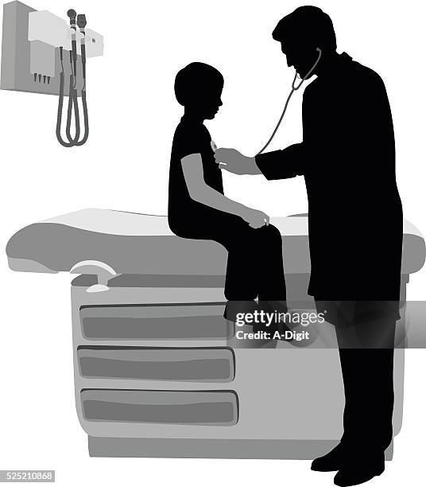


-2010 University of Yamanashi, Japan (MD)
2010-2015 Post-graduate training in Japan
(Board of Pediatrics)
2015-2018 Pediatric residency in Brooklyn, NY
(Board of Pediatrics)
2018-2021 Pediatric Hem/Onc fellowship at UMN
(Board of Peds Hem/Onc)
2019-2022 PhD at ECP, UMN
(Advisor: Mark Kirstein, Mahmoud Al-Kofahi)
2021-2022 Pediatric SCT fellowship at BCH/DFCI, MA
2022-2024 Instructor
2024- Assistance Professor

Slide 4
Agenda
What is MIPD
Why/when is MIPD needed
Landscape of clinical “precision dosing”
MIPD via a software (InsightRx®)
Novel MIPD research (voriconazole)

Slide 5
What is MIPD?
Model-informed precision dosing (MIPD) is an advanced quantitative approach focusing on individualized dosage optimization, integrating complex mathematical and statistical models of drugs and disease combined with individual demographic and clinical patient characteristics.
→ PMx at the bedside!

Slide 6
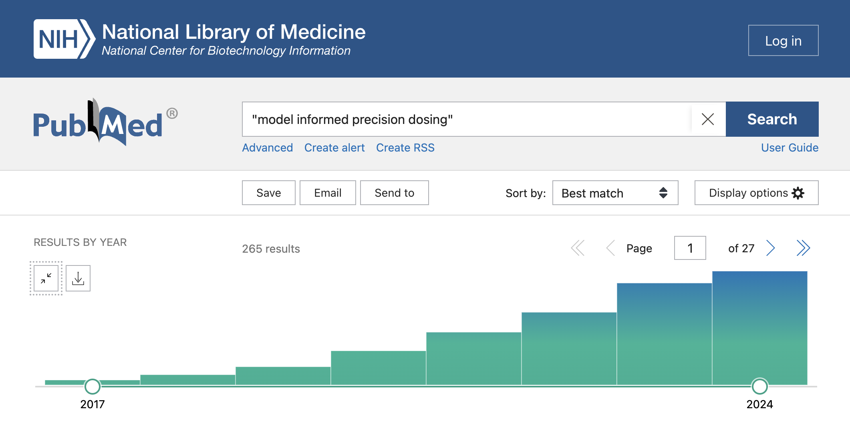
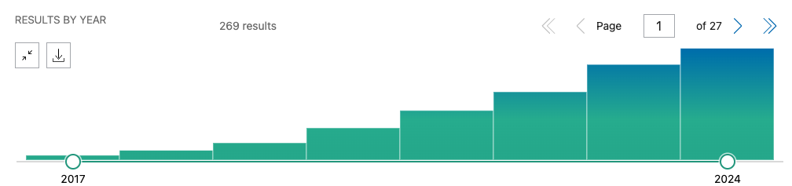

What is MIPD?
Clinical field | N | Drugs
Infectious disease | 114 (43%) | Vancomycin, piperacillin, anti-TB, azoles
Transplant | 32 (12%) | Busulfan (9), immunosuppression (15), anti-T cell therapy (4), eculizumab (3)
IBD | 18 (7%) | Infliximab, adalimumab
Psychiatry/seizure | 16 (6%) | SSRI, clozapine, olanzapine, VPA, lamotrigine
Oncology | 15 (6%) | Tamoxifen
Neonates | 11 (4%) | Caffeine
Other drugs | 15 (5%) | Warfarin, rivaroxaban, Factor 7
No drug/field named | 44 (17%) | (methodology, reviews)

Slide 7

Why is MIPD needed
？
Dose -> PK → Drug Exposure → PD - > Response
？
Pathology
- Pathology
Biology
Immunology
Genomics
A: Absorption
D: Distribution
E: Elimination
M: Metabolism
Biomarker
Survival
Relapse
Exposure

Slide 8
Why is MIPD needed
Dose -> PK → Drug Exposure → PD -> Response
PK
PD
- Biology
- Immunology
- Pathology
A: Absorption
D: Distribution
E: Elimination
M: Metabolism
Survival
TRM
Relapse
Exposure
Ph-like ALL,
FLT3-ITD AML

Slide 9
Why is MIPD needed
Dose -> PK → Drug Exposure → PD -> Response
More difficult to predict
Easier to predict
PK
- Biology
- Immunology
- Pathology
PD
A: Absorption
D: Distribution
E: Elimination
M: Metabolism
Biomarker
Survival
Relapse
Exposure

Slide 10
Why is MIPD needed
Abatacept 10 mg/kg
(n = 186, PEDI/Adults, Phase 2)
Cyclophosphamide 50 mg/kg
adjusted for obesity
(n = 85, Adults, clinical)
ATG 1.25 mg/kg, days -2, -1
(n = 86, Adults, clinical)
?
?
?

Slide 11
Exposure variability is large!
Abatacept 10 mg/kg
(n = 186, PEDI/Adults, Phase 2)
Cyclophosphamide 50 mg/kg
adjusted for obesity
(n = 85, Adults, clinical)
ATG 1.25 mg/kg, days -2, -1
(n = 86, Adults, clinical)
~4-fold difference
~10-fold difference
~3-fold difference

Slide 12
Does Phase 1 study address PKPD?
N of patients
Dose level
2
N of patients
Dose level
1
Dose level
2
Dose level
3
Drug exposure
(mg/L)
Poor
efficacy
Too
toxic
Phase 2 & 3 studies
Drug exposure
(mg/L)
Dose finding study

Slide 13
Does Phase 1 study address PKPD?
N of patients
Dose level
2
N of patients
Dose level
1
Dose level
2
Dose level
3
Drug exposure
(mg/L)
Poor
efficacy
Too
toxic
Phase 2 & 3 studies
Drug exposure
(mg/L)
N of patients
Dose finding study
Under
therapeutic
Super
therapeutic
Drug exposure
(mg/L)
Model-based precision dosing
Where is the window (PD)?
How to fit the cohort within the window (PK)?

Slide 14
When is MIPD indicated?
Clinical field | N | Drugs
Infectious disease | 114 (43%) | Vancomycin, piperacillin, anti-TB, azoles
Transplant | 32 (12%) | Busulfan (9), immunosuppression (15), anti-T cell therapy (4), eculizumab (3)
IBD | 18 (7%) | Infliximab, adalimumab
Psychiatry/seizure | 16 (6%) | SSRI, clozapine, olanzapine, VPA, lamotrigine
Oncology | 15 (6%) | Tamoxifen
Neonates | 11 (4%) | Caffeine
Other drugs | 15 (5%) | Warfarin, rivaroxaban, Factor 7,
No drug/field named | 44 (17%) | (methodology, reviews)

Slide 15
Agenda
What is MIPD
Why/when is MIPD needed
Landscape of clinical “precision dosing”
MIPD via a software (InsightRx®)
Novel MIPD research (voriconazole)

Slide 16
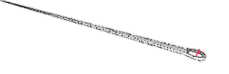
When MIPD is indicated?
1. Need to thread a needle (PD)
- Clear exposure-response associations
- A narrow therapeutic window
2. One size DOES NOT fit all (PK)
- Variable exposure at a standard dosing
3. Blind dose adjustment is difficult (clinical)
- Difficult to titrate dose based on clinical response or biomarkers (long latency, too toxic, single dose, etc)
4. Validated bioanalytical method (lab)
- CLIA certified test with a timely turnaround time
Under
therapeutic
Super
therapeutic
Drug
exposure
(mg/L)
N of patients
Dose level
1 2 3
Drug exposure
(mg/L)

Slide 17

What is on the flipside? Perfect is the enemy of good
1. Need to thread a needle (PD)
- Clear exposure-response associations
- A narrow therapeutic window
2. One size DOES NOT fit all (PK)
- Variable exposure at a standard dosing
3. Blind dose adjustment is difficult (clinical)
- Difficult to titrate dose based on clinical response or biomarkers (long latency, too toxic, single dose, etc)
4. Validated bioanalytical method (lab)
- CLIA certified test with a timely turnaround time
Convenience
Is conventional approach good enough?
Fit one size to all and adjust the dose by trials and errors
VS.

Slide 18
How to do MIPD?
A priori
Individualize the starting dose based on previous knowledge
Population PK parameters (THETAs)
A posteriori (TDM)
Individualize the subsequent dose based on BOTH previous knowledge and observation (Bayesian forecast)
Individual PK parameters (THETAs + ETAs = EBEs)

Slide 19
Agenda
What is MIPD
Why/when is MIPD needed
Landscape of clinical “precision dosing”
MIPD via a software (InsightRx®)
Novel MIPD research (voriconazole)

Slide 20
Landscape of a priori “precision dosing”
Dosing methods | Patient parameter | CL function | Clinical implementation
mg | 0 | Constant | None
mg/kg | 1 | Linear | None
mg/m² | 1 | Linear | EMR, trained staff
mg, mg/kg, mg/m² in strata | 2 | Stratified linear | None, EMR, trained staff
mg/kg^{0.75}, mg = f(x) | 1-2 | Nonlinear | Nomogram
mg = f(x1, x2, …) | 3+ | Nonlinear | Dose calculator (spreadsheet, software)
Complex

Slide 21
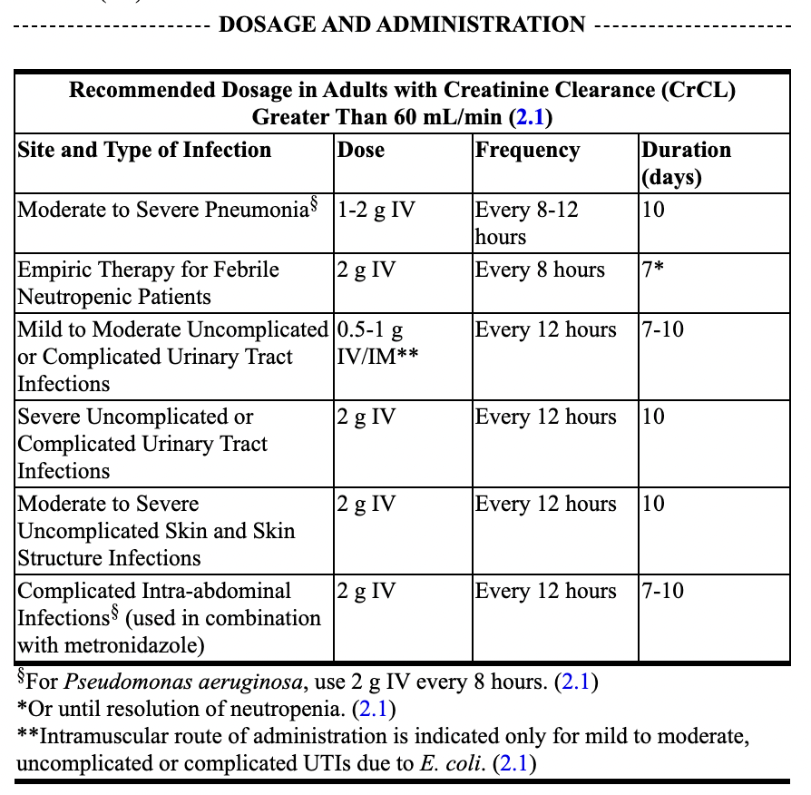
Landscape of a priori “precision dosing”
MAXIPIME- cefepime injection
(FDA package insert)
Dosing methods | Patient parameter | CL function | Clinical implementation
mg | 0 | Constant | None
mg/kg | 1 | Linear | None
mg/m² | 1 | Linear | EMR, trained staff
mg, mg/kg, mg/m² in strata | 2 | Stratified linear | None, EMR, trained staff
mg/kg^{0.75}, mg = f(x) | 1-2 | Nonlinear | Nomogram
mg = f(x1, x2, …) | 3+ | Nonlinear | Dose calculator (spreadsheet, software)
Complex

Slide 22
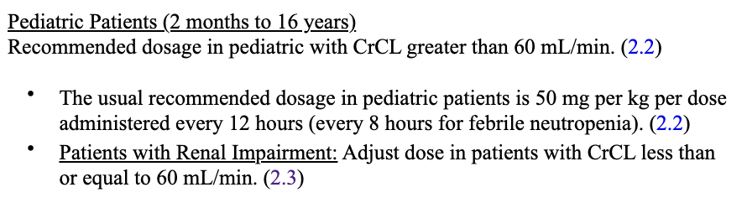
Landscape of a priori “precision dosing”
Dosing methods | Patient parameter | CL function | Clinical implementation
mg | 0 | Constant | None
mg/kg | 1 | Linear | None
mg/m² | 1 | Linear | EMR, trained staff
mg, mg/kg, mg/m² in strata | 2 | Stratified linear | None, EMR, trained staff
mg/kg^{0.75}, mg = f(x) | 1-2 | Nonlinear | Nomogram
mg = f(x1, x2, …) | 3+ | Nonlinear | Dose calculator (spreadsheet, software)
MAXIPIME- cefepime injection
(FDA package insert)
Complex

Slide 23
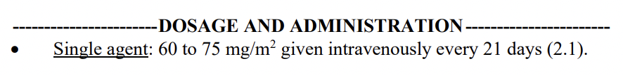
Landscape of a priori “precision dosing”
Dosing methods | Patient parameter | CL function | Clinical implementation
mg | 0 | Constant | None
mg/kg | 1 | Linear | None
mg/m² | 1 | Linear | EMR, trained staff
mg, mg/kg, mg/m² in strata | 2 | Stratified linear | None, EMR, trained staff
mg/kg^{0.75}, mg = f(x) | 1-2 | Nonlinear | Nomogram
mg = f(x1, x2, …) | 3+ | Nonlinear | Dose calculator (spreadsheet, software)
DOXORUBICIN HYDROCHLORIDE injection
(FDA package insert)
Complex

Slide 24
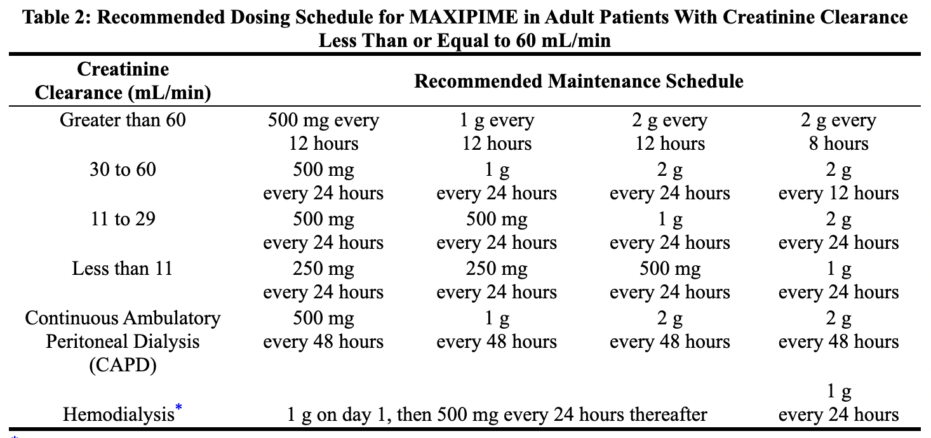
Landscape of a priori “precision dosing”
MAXIPIME- cefepime injection
(FDA package insert)
Dosing methods | Patient parameter | CL function | Clinical implementation
mg | 0 | Constant | None
mg/kg | 1 | Linear | None
mg/m² | 1 | Linear | EMR, trained staff
mg, mg/kg, mg/m² in strata | 2 | Stratified linear | None, EMR, trained staff
mg/kg^{0.75}, mg = f(x) | 1-2 | Nonlinear | Nomogram
mg = f(x1, x2, …) | 3+ | Nonlinear | Dose calculator (spreadsheet, software)
Pediatric Patients
Data in pediatric patients with impaired renal function are not available; however, since cefepime pharmacokinetics are similar in adults and pediatric patients, changes in the dosing regimen proportional to those in adults are recommended for pediatric patients.
Complex

Slide 25
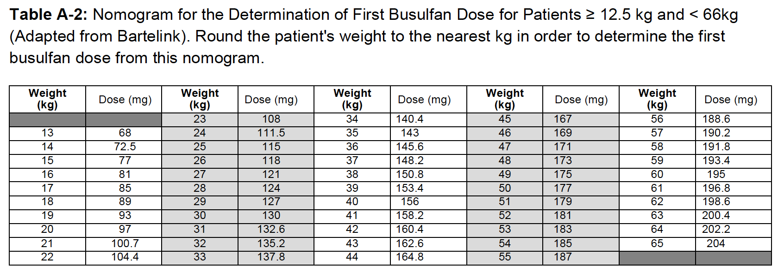
Landscape of a priori “precision dosing”
Dosing methods | Patient parameter | CL function | Clinical implementation
mg | 0 | Constant | None
mg/kg | 1 | Linear | None
mg/m² | 1 | Linear | EMR, trained staff
mg, mg/kg, mg/m² in strata | 2 | Stratified linear | None, EMR, trained staff
mg/kg^{0.75}, mg = f(x) | 1-2 | Nonlinear | Nomogram
mg = f(x1, x2, …) | 3+ | Nonlinear | Dose calculator (spreadsheet, software)
Busulfan dosing (UMN clinical protocol)
Dose = ƒ(WT)
Complex

Slide 26
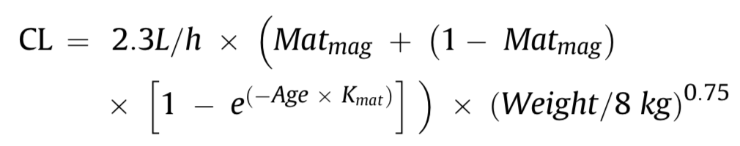
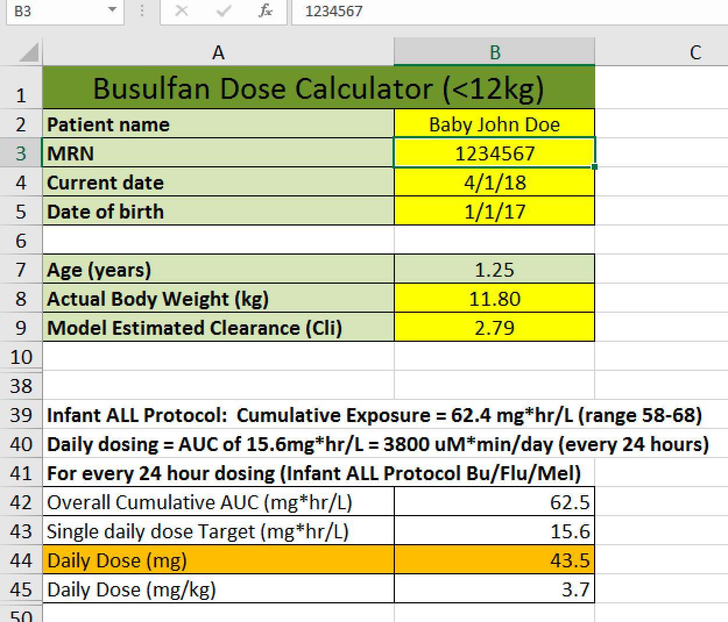
Landscape of a priori “precision dosing”
Busulfan dosing (UMN clinical protocol)
Dosing methods | Patient parameter | CL function | Clinical implementation
mg | 0 | Constant | None
mg/kg | 1 | Linear | None
mg/m² | 1 | Linear | EMR, trained staff
mg, mg/kg, mg/m² in strata | 2 | Stratified linear | None, EMR, trained staff
mg/kg^{0.75}, mg = f(x) | 1-2 | Nonlinear | Nomogram
mg = f(x1, x2, …) | 2+ | Nonlinear | Dose calculator (spreadsheet, software)
Dose = ƒ(WT, AGE)
Complex

Slide 27
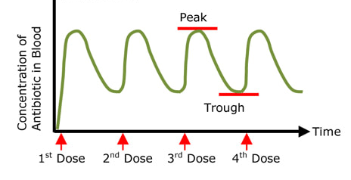
Landscape of a posteriori “precision dosing”
1. Single-point TDM at steady state
Trough:
Vancomycin (5-15 mcg/mL), voriconazole (1-5 mcg/mL), tacrolimus (5-15 ng/mL), cyclosporine (200-400 ng/mL), gentamicin (0.5-2 ug/mL), etc.
Peak:
Gentamicin (5-10 ug/mL)
2. AUC-based TDM
- NCA (intensive PK study per dose)
3. Model-based TDM
- Bayesian forecasting (limited PK sampling)

Slide 28
Agenda
What is MIPD
Why/when is MIPD needed
Landscape of clinical “precision dosing”
MIPD via a software (InsightRx®)
Novel MIPD research (voriconazole)

Slide 29



An example of MIPD via a user interface software
InsightRX is a healthcare technology company that provides a cloud-based clinical decision support platform that applies quantitative pharmacology and artificial intelligence (AI) to enhance therapeutic decision-making from phase I drug development through to individualized patient treatment at the point of care.
MIPD software used in UMN, BCH, MSKCC, etc.
Can be integrated in EPIC

Slide 30
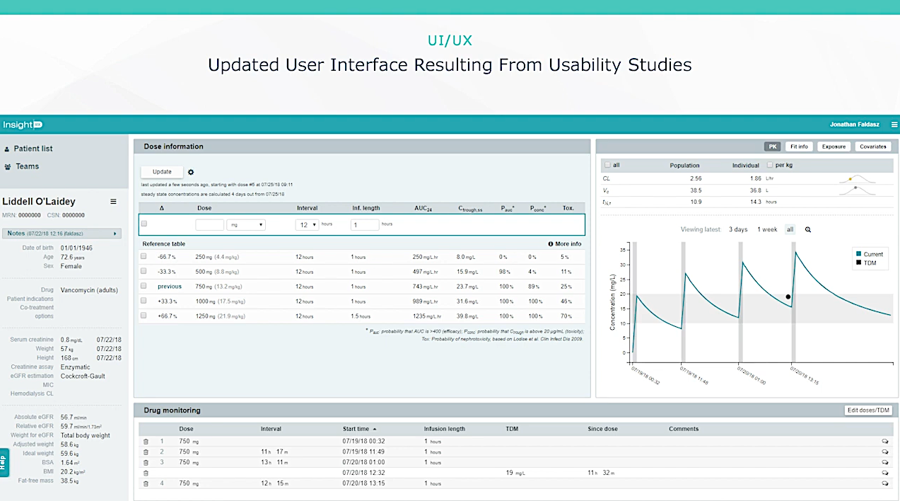

Slide 31
Model fitting
Patient covariates
New dose planning
Actual dosing and PK data

Slide 32
Agenda
What is MIPD
Why/when is MIPD needed
Landscape of clinical “precision dosing”
MIPD via a software (InsightRx®)
Novel MIPD research (voriconazole)

Slide 33

Voriconazole TDM (MIPD) project
Unmet needs:
- A common antifungal agent in oncology, HSCT, etc
- Voriconazole has a large PK variation and critical DDI (e.g., tacro, CSA, clopidogrel)
- Its long half-life and bioassay challenge the current TDM strategy (trough at SS)
Case:
2 yo with ALL started prophylactic Vori after HSCT.
- Trough day +5: <0.5 -> dose up by ~20% -> day +10: <0.5 -> -> -> day +20: <0.5
- Constantly affected tacro concentrations…

Slide 34
Voriconazole TDM (MIPD) project
Strategy 1: Rapid TDM
- Perform and repeat trough-based TDM before steady state (e.g., half of the T1/2)
Strategy 2: Early Bayesian TDM
- Perform serial PK sampling after the first dose, and PK parameter-based TDM
Progress:
A clean dataset of pediatric HSCT on prophylactic vori with intense PK x2 (n = 58)
PPK models developed x2 (parent-metabolite on occasion 1, BOV model)

